Slide 1


Unit 5
HHFA data analysis platform
and global archive
Notes:
Welcome to Unit 5 of Module 3.

Slide 2
By the end of this unit, you will be able to:
explain the functions of the HHFA data analysis platform
describe the HHFA global archive
Notes:
By the end of this unit, you will be able to explain the functions of the HHFA data analysis platform, and briefly describe the HHFA global archive.

Slide 3
HHFA data analysis platform
1
2
3
4
5
6
7
Decide information needs
Adapt questionnaire & CSPro tool
Train data collectors
Collect data
Analyse data
Interpret, communicate & use data
Curate data
Data analysis platform
Notes:
The HHFA data analysis platform is a tool to support Step 5 in the 7 key steps of the HHFA.

Slide 4




What is the HHFA data analysis platform?
data collection
exported from CSPro tool
data analysis platform
online software application
Notes:
The HHFA data analysis platform is an online software application that was specially built for the HHFA.
When data collection is complete and the data have been cleaned, the HHFA data are exported from the CSPro tool and uploaded to the data analysis platform.

Slide 5

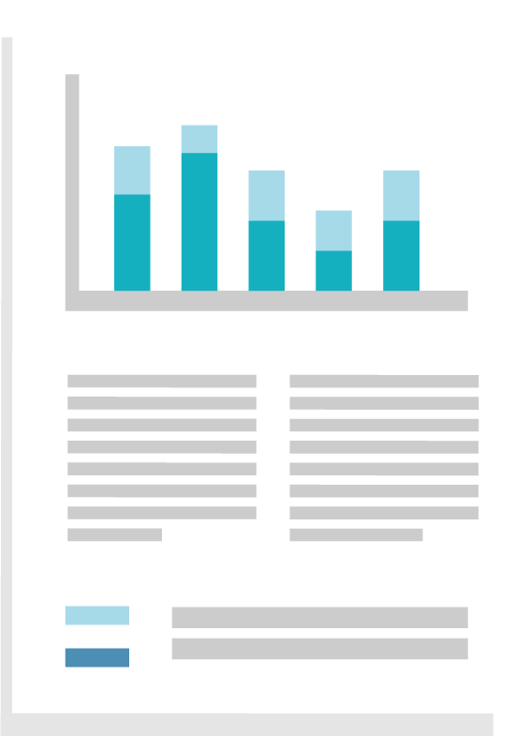
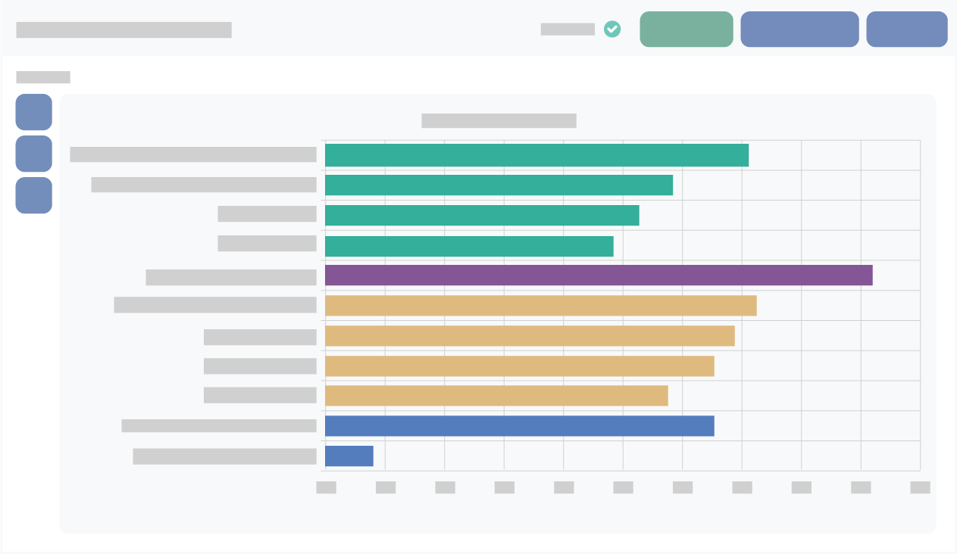
What is the HHFA data analysis platform?
The data analysis platform enables automated:
calculation of indicators
generation of standard tables and graphs
generation of a report outline
analysis platform outputs
Notes:
The data analysis platform enables automated:
calculation of indicators;
generation of standard tables and graphs; and
generation of a report outline that serves as the framework for the final country HHFA report.
These are called the analysis platform outputs.
This automation means that you don’t need any specialized statistical software or expertise to conduct data analysis.

Slide 6
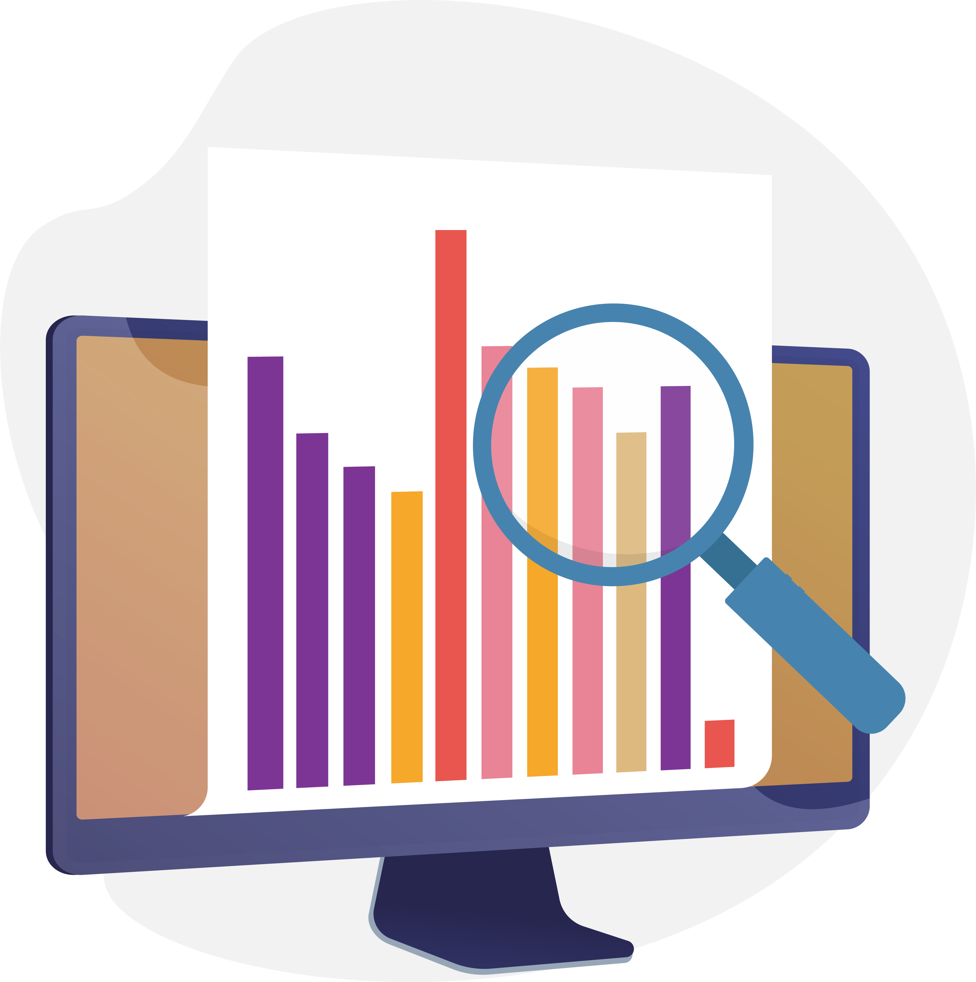

What is the HHFA data analysis platform?
Notes:
Using the platform also saves a lot of time that would otherwise be spent on data analysis.
However, if the country prefers, they can export the data to any statistical software of their choice (for example, Stata, or SPSS, or even Excel) to conduct the analysis.

Slide 7
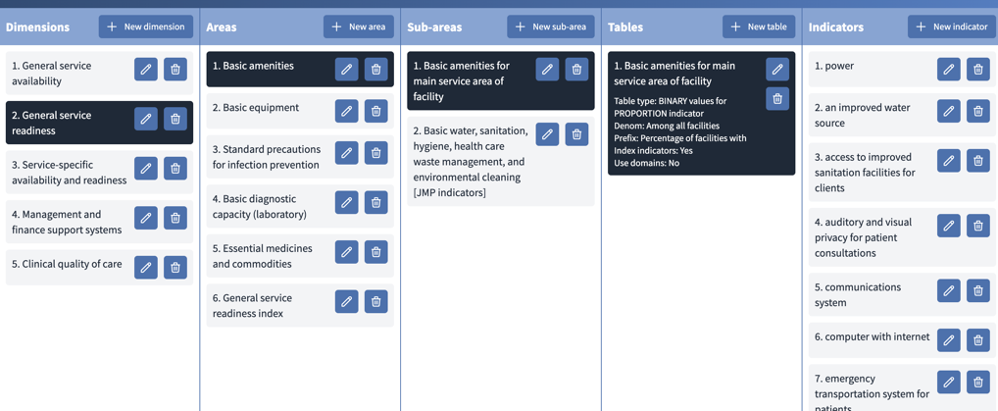
Using the HHFA data analysis platform
Dimensions
Areas
Sub-areas
Tables
Indicators
Notes:
The data analysis platform and the outputs it produces are organized according to the same groups used in the indicator platform.
These are:
dimensions;
areas;
sub-areas;
tables; and
indicators.

Slide 8
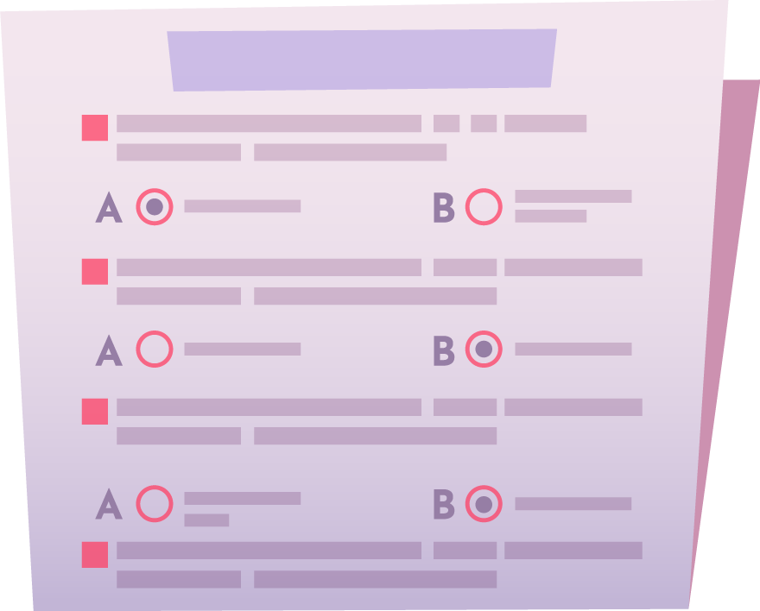

Using the HHFA data analysis platform
Notes:
The platform must be configured for the country before uploading the completed survey data set.
If necessary, country-specific indicators and tables must be created, based on country-specific changes to the questionnaire.
If there were minimal changes to the questionnaire, minimal adaptation of the analysis platform will be needed. However, it will still need to be configured for the specific country.

Slide 9
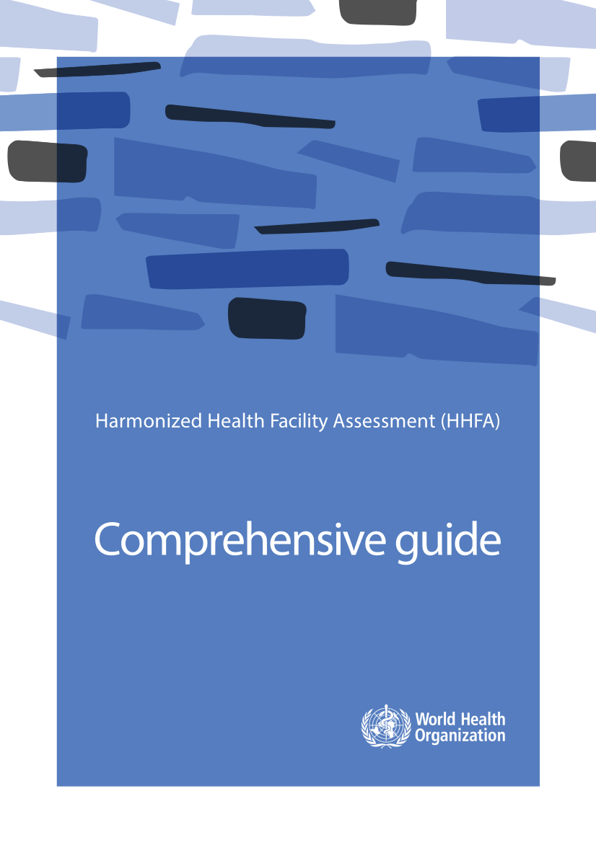

HHFA data analysis platform guidance
HHFA Comprehensive guide
HHFA Data analysis platform
OpenWHO course
Notes:
Details about how to adapt and use the data analysis platform can be found in the HHFA Comprehensive guide and in the HHFA Data analysis platform OpenWHO course.

Slide 10
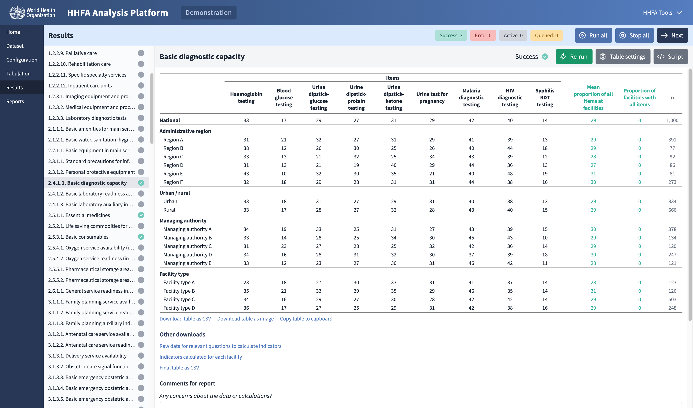
HHFA data analysis platform: Example table
National
Region
Urban/rural
Managing authority
Facility type
Notes:
Let’s take a look at the data analysis interface. This is an example of a table produced by the platform.
It shows the percentage of facilities offering basic laboratory tests, at national level, and by region, urban/rural location, managing authority, and facility type.

Slide 11
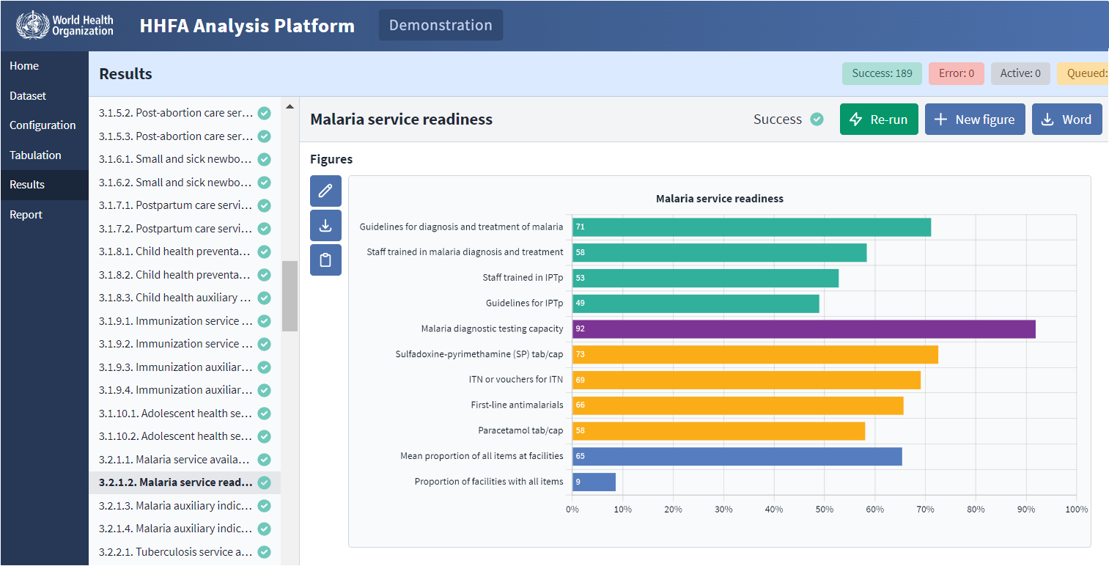
HHFA data analysis platform: Example graphs
Malaria service readiness indicators
Notes:
The data analysis platform also visually presents data in the form of graphs.
This graph shows the indicators for malaria service readiness for national level.

Slide 12
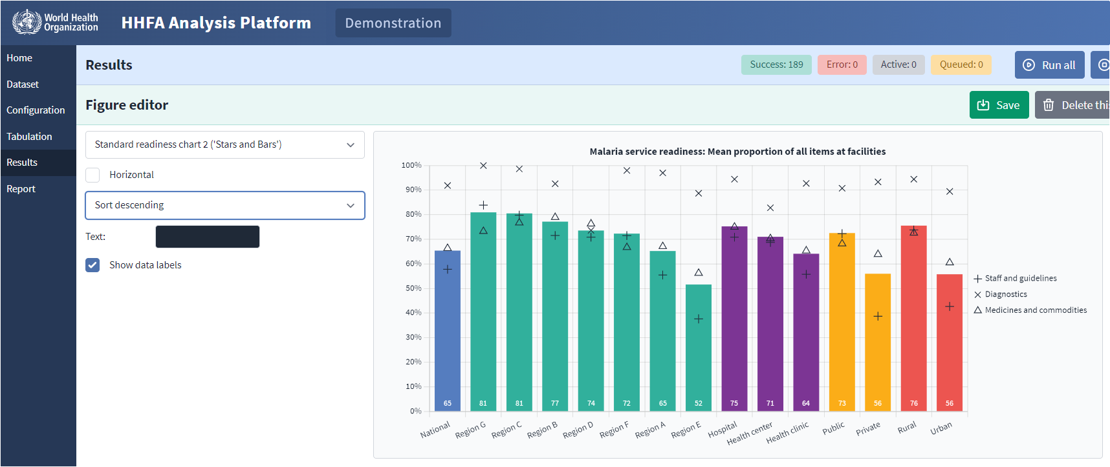
HHFA data analysis platform: Example graphs
Urban/rural location
Management authority
Region
Facility type
Notes:
This second graph shows one of the indicators ﻿from the previous graph. The indicator is: the mean proportion of all malaria items at facilities. This indicator is also the overall readiness index for this table. The graph shows the index by region, facility type, management authority, and urban or rural location.

Slide 13
Global HHFA archive
1
2
3
4
5
6
7
Decide information needs
Adapt questionnaire & CSPro tool
Train data collectors
Collect data
Analyse data
Interpret, communicate & use data
Curate data
Global HHFA archive
Notes:
We will now look at another tool in the HHFA resource package – the Global HHFA Archive. The global archive supports Step 7 in the 7 key steps of the HHFA.

Slide 14

Global HHFA archive
After finalization of HHFA data analysis, it is essential that:
the data set is securely catalogued and archived
processes are established for the data to be accessed by the MOH and researchers
This process is called data curation.
Notes:
After finalization of HHFA data analysis, it is essential that:
the data set is securely catalogued and archived; and
processes are established for the data to be accessed by the ministry of health, researchers and other users in the future.
This process is called data curation.
The HHFA Comprehensive guide provides guidance on the curation process.

Slide 15
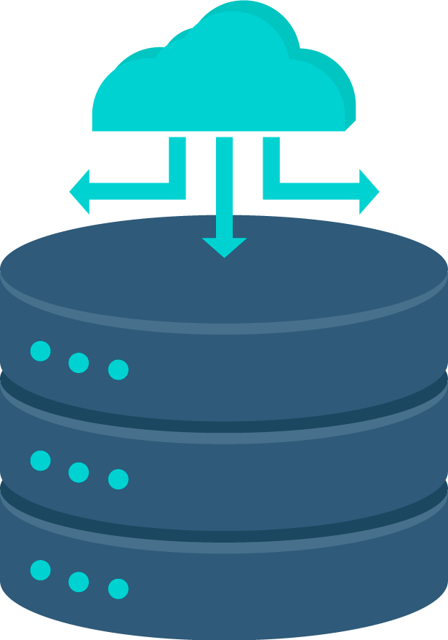
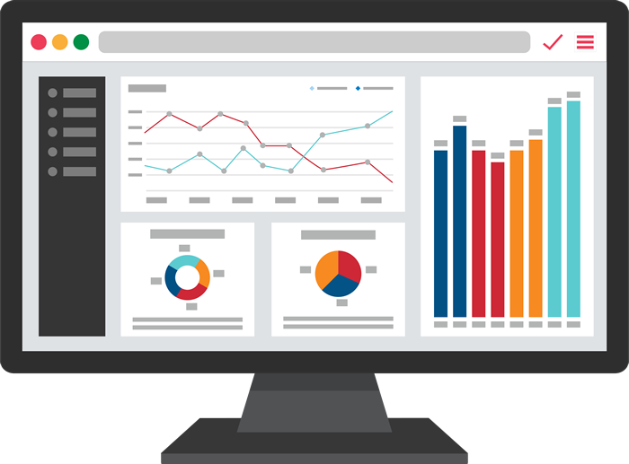
Global HHFA archive
A country should have its own data curation processes and archiving facilities.
Missed opportunities for making optimal use of the data.
Notes:
A country should have its own data curation processes and archiving facilities.
However, experience has shown that SARA and HHFA reports and data are sometimes “lost” or forgotten, or not easily accessible to users.
The consequence is missed opportunities for making optimal use of the data.

Slide 16


Global HHFA archive
Notes:
WHO has developed secure, central storage options for countries to archive their HHFA and SARA data sets and reports through a global HHFA/SARA archive.

Slide 17

Global HHFA archive
HHFA website
https://www.who.int/data/data-collection-tools/harmonized-health-facility-assessment/introduction
Notes:
Countries can also opt to make the final HHFA report and/or the data set publicly available through a link to the global HHFA archive on the WHO HHFA website.

Slide 18
You have now completed Unit 5.
In the next unit, we will look at the detailed HHFA planning and implementation activities.
Notes:
You have now completed Unit 5.
In the next unit, we will look at the detailed planning and implementation activities needed for conducting an HHFA.

